Slide 1
AWS Hands-On Session 20/01/2020

Slide 2
Welcome! We will be starting in 3 minutes
We will prepare for Cloud Practitioner Exam – CLF C01
This is very challenging certification so it is going to be little lengthy
We will cover 50 AWS services required for this exam out of 200+ AWS services
We will be learning by doing – This is going to be key learning technique. (I will explain each concept by doing hands-on)

Slide 3
Cloud Computing Overview
On demand scalability
Separate IT team to manage infrastructure
Globally Scalability issues
Very costly and difficult to Manage

Slide 4
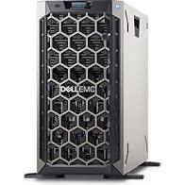
Cloud Computing Overview
10k users

Slide 5
Cloud Computing Types
Infrastructure as a service - IAAS
Platform as a Service - PAAS
Software as a Service - SAAS

Slide 6
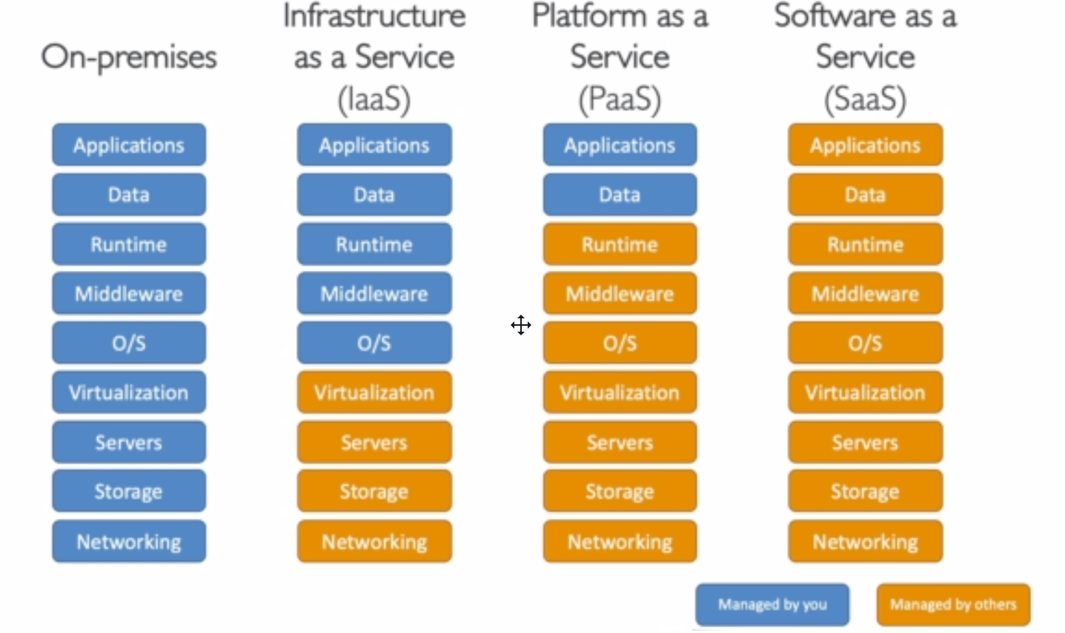
Cloud Computing Types - Comparison

Slide 7
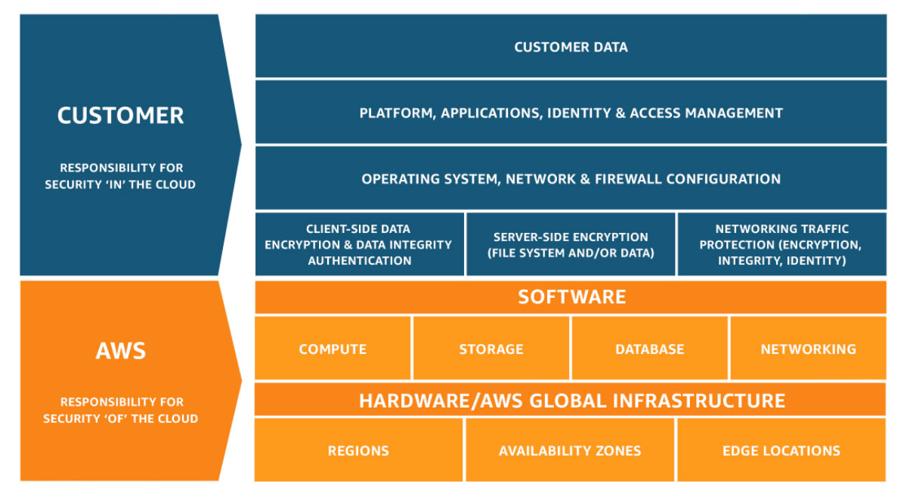
Shared Responsibility Model Diagram

Slide 8
Identity & Access Management - IAM
IAM Allows you to manage users and their level of access management to the AWS console & Services. IAM is globally available and not specified to region.
Terminology
- **Users** - End users (people)
- **Groups** - Collection of users under one set of permissions
- **Roles** - Permissions defined for AWS resources (i.e. EC2 etc.)
- **Policy Documents** - Document that defines one or more permissions - JSON format
- **Root account** - user used to sign into AWS account

Slide 9


IAM Shared Responsibility Model
Infrastructure – Servers, Storage
Security of Network
Configuration and Vulnerability Analysis
Compliance Validation
User, group, roles, policies
MFA
Key management
Usage of IAM for Managing and applying permissions
Analysis of Access Patterns
Permissions review
AWS is responsible for all the infrastructure and you are responsible for how you use that
infrastructure.

Slide 10
Overview for IAM
Policy is a JSON document that outlines users and groups
Groups can only contain users
It is not needed for a user to be a part of any group
IAM is a global service
Roles are used for EC2 service or AWS services
Enable MFA to add extra layer for securing a user
Access keys enables CLI or SDK to access AWS
IAM Access Advisor and IAM Credential report for Audit

Slide 11
EC2 Overview
EC2 – Elastic Compute Cloud
AWS EC2 is a service that provides re-sizable compute capacity in the cloud. EC2 reduces the time required to obtain and boot new server instances to minutes, allowing you to quickly scale capacity, both up and down, as your computing requirements change.
Infrastructure as a service offering from AWS
EC2 has changed the economics of cloud computing by allowing you to pay only for capacity that your actually use.
EC2 provides developers the tools to build failure resistant applications and isolate themselves from common failure scenarios.

Slide 12
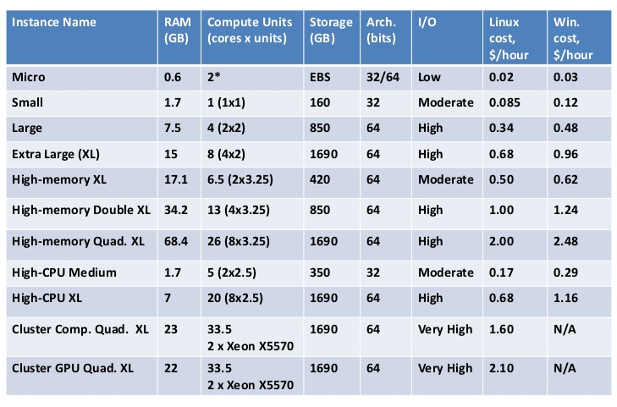
EC2 Instance Types
Free Tier

Slide 13
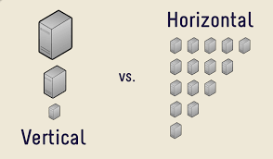
Vertical vs Horizontal Scaling

Slide 14
EC2 Instance Purchasing Options
On Demand Instances: short workload, predictable pricing Reserved Instances: long workloads (≥ 1 year) Convertible Reserved Instances: long workloads with flexible instances Scheduled Reserved Instances: launch within time window you reserve Spot Instances: short workloads, for cheap, can lose instances Dedicated Instances: no other customers will share your hardware Dedicated Hosts: book an entire physical server, control instance placement

Slide 15
EC2 On Demand Instances
On-Demand Instances
Pay, by the second, for the instances that you launch.
No longer-term commitments or upfront payments are needed.
You have full control over its lifecycle, you decide when to launch, start, stop, reboot, or terminate it.
You pay only when your On-Demand Instances are in the running state.
Can increase or decrease your compute capacity.

Slide 16
EC2 Reserved Instances
Reserved Instances
Up to 75% savings compared to On-Demand Instance pricing.
You can purchase a Reserved Instance for a one-year or three-year commitment, with the three-year commitment offering a bigger discount.
Commitment includes instance type and Region.
Reserved Instances do not renew automatically; when they expire, you can continue using the EC2 instance without interruption, but you are charged On-Demand rates.
After you purchase a Reserved Instance, you cannot cancel your purchase. However, you may be able to modify, exchange, or sell your Reserved Instance if your needs change.

Slide 17
EC2 Scheduled Reserved Instances
Scheduled Reserved Instances
Purchase instances that are always available on the specified recurring schedule.
Recur on a daily, weekly, or monthly basis, with a specified start time and duration.
You pay for the time that the instances are scheduled, even if you do not use them.
After you purchase a Scheduled Instance, you can't cancel, modify, or resell your purchase.
You must purchase a Scheduled Reserved Instance minimum for one year.
The minimum required utilization is 1,200 hours per year.

Slide 18
EC2 Scheduled Reserved Instances
Spot Instances
The most cost-efficient instance in AWS. Up to 90% savings compared to On-Demand Instance pricing.
Request unused EC2 instances, which can reduce your Amazon EC2 costs significantly.
Instances that can "lose" at any point of time if your max price is less than the current spot price.
Well-suited for batch jobs, background processing, and optional tasks. Not good for critical jobs.

Slide 19
EC2 Dedicated Hosts
Dedicated Hosts
Pay for a physical host.
Physical server with EC2 instance capacity fully dedicated to your use.
Full control of the Instance placement.
Visibility into the underlying socket, the core of the hardware.
You must purchase a Dedicated Hosts Instance minimum for one year.

Slide 20
EC2 Dedicated Instances
Dedicated Instances
Pay, by the hour, for instances that run on hardware that's dedicated to a single customer.
May share hardware with other instances from the same AWS account.

Slide 21
EC2 Great Combo
Great combo
Reserved Instance for baseline + On-Demand and Spot Instances for scaling.

